Slide 1

Project OneView
Divya Vishnumurthy
Kevin Kao
Joe Strawinski
Harshavardhan Suresh
Ramesh Kalagnanam

Slide 2

Agenda
Explain :
Initial load of Data
Framework Architecture
Technologies used
Challenges
Overcoming hurdles using Agile methodologies.
App Demo
Concept
Better Price
Quicker Decisions
Better Experience
No regrets

Slide 3
OneView= Enhance.BrickSeek
BrickSeek is a web-based software that allows you to search for sale and clearance deals near your ZIP Code. BrickSeek focuses on several major retailers including Walmart, Target, Lowe’s, Office Depot, Macy’s, Home Depot, CVS, Staples and BJ’s.
Why:
BrickSeek in its current state has a paid membership + lacks functionality and is limited to localized area (i.e. cannot analyze nationwide supply and pricing trends)
Who:
For the deal hunter, holiday shopper and online reseller
What:
OneView enables the user to see a nationwide view of inventory and pricing information from big box retailers to spot trends + analyze products + make informed purchases + strategic pricing decisions
Notes:
The Future of retail is E-commerce. Amazon is a secondary marketplace that takes advantage of market imbalances and fills the gap for local shortages. When products are out of stock locally people resort to amazon to fill the need. And in times of the holidays people are willing to pay any price.
There is always a small window of opportunity for a buyer to get the best deal for item in need. Our framework will work on empowering the buyer in this window to make the best decision.
BrickSeek bridges the gap between online and in-store to bring buyers price comparison tools and the best deals around. However it has limitations on the data being isolated to a city or a region.
For project 2, we will enhance the data provided by Brick Seek which is quite localized to include data across United States and display the trends for an item price and inventory helping the buyer to understand the demand and supply attributes.

Slide 4




Getting data ready
Data Cleaning (Process)
Data Backup (Store)
Analyze
Data Gathering from BrickSeek (Collect)
Data Storage for retrieval
1. Load Database w/ZIP Codes: started with a dataset of ZIP Codes with a population greater than 100K + manually included additional cities to provide a better representation of the entire country
2. Get BrickSeek data – make CURL calls
Curl --data “sku=&zip=“ https://brickseek.com/walmart-inventory-checker?
3. Scrape data using Beautiful Soup and load the database

Slide 5
Challenges
Limited funding for Cloud Component
BrickSeek request rejects
Slow application – due to heavy database calls
App is dependent on scraped data + looping thru 400+ ZIP Codes
Limitations on infancy of database – lack of historical data to perform more advanced analytics
Difference in access variables across different inventories (SKUvs.DPCI)
https://brickseek.com/walmart-inventory-checker?sku=329264833
https://brickseek.com/target-inventory-checker?sku=080-02-1714

Slide 6










Architecture overview
Cloud component for high availability
Cloud component for remote access
Front End
HTML, CSS, JavaScript libraries.
Middleware
Python Flask
Database calls
File system calls
Beautiful Soup
CURL for web scraping
Cloud component
Heroku
Postgres Database
Google API for maps
Filesystems for caching
BrickSeek
Source of Data

Slide 7
Technologies used
FRONTEND
JavaScript libraries
Charts.js
Plotly.js
D3.js
Leafletjs
Bootstrap
HTML
MIDDLEWARE
Python Flask
SQLAlchemy
OS, SYS, Pandas, JSON, Beautiful Soup
UNIX utility-CURL
BACKEND
File system
Postgres Database on Heroku
BEST PRACTICES
Re-usable code components
Filesystem backup
Database on cloud for high availability
Centralized database for remote access
Use of bootstrap templates

Slide 8
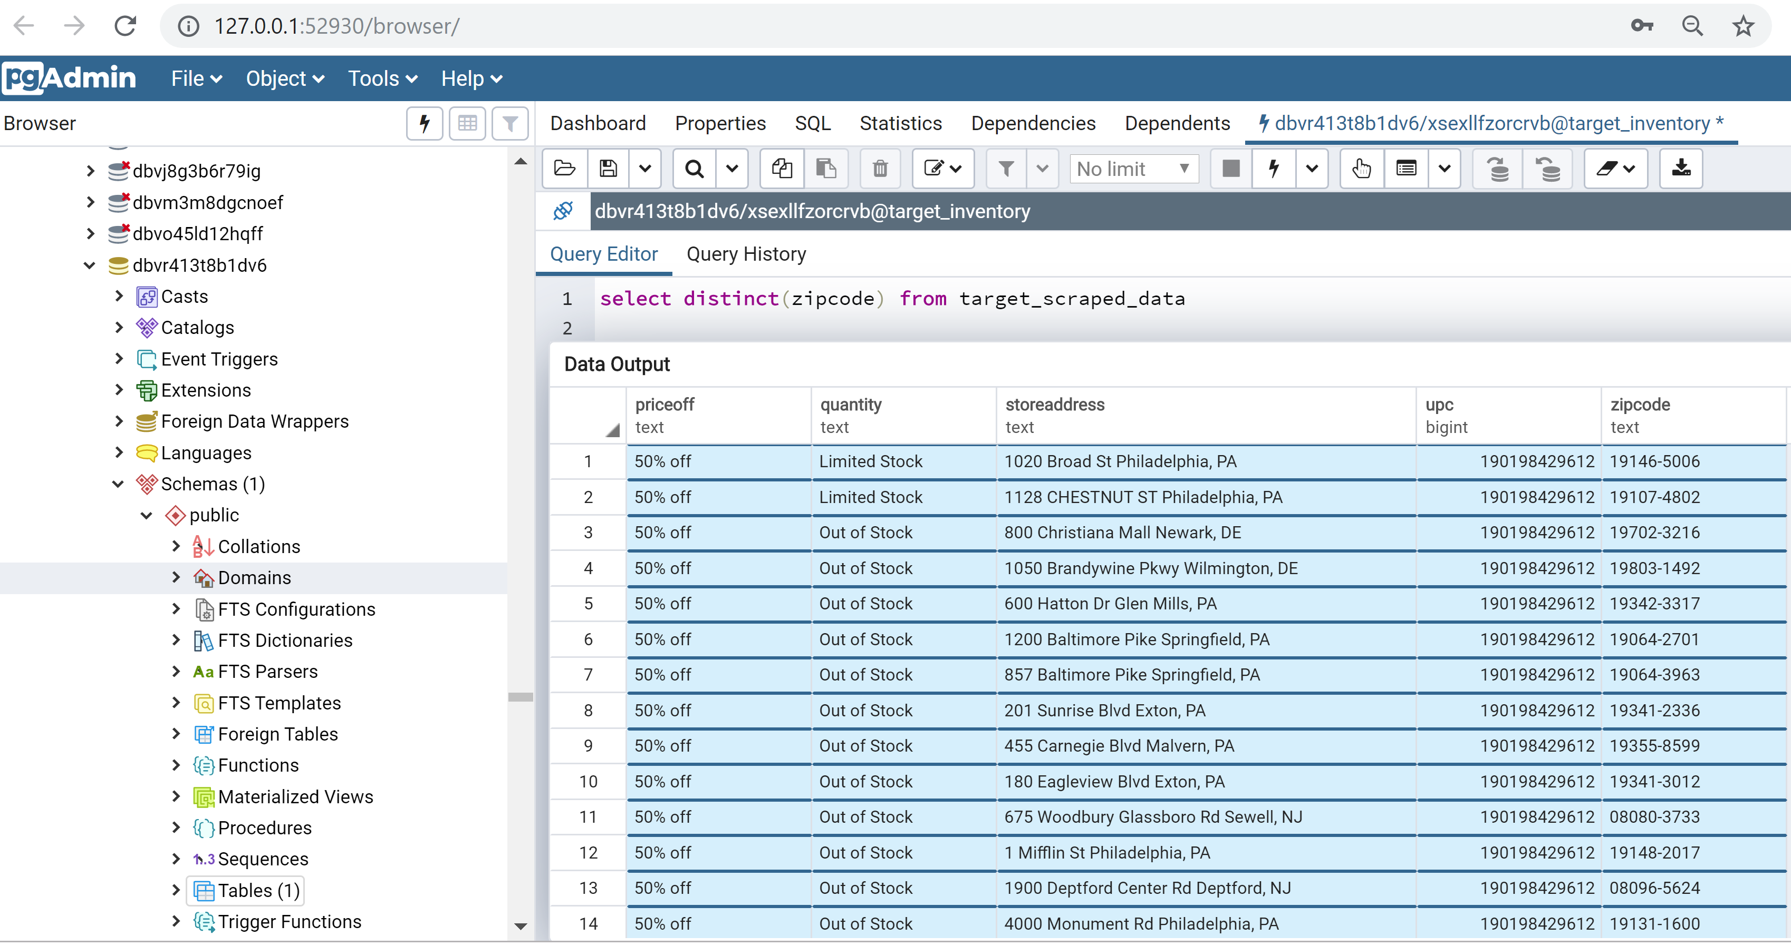
Cloud Database

Slide 9
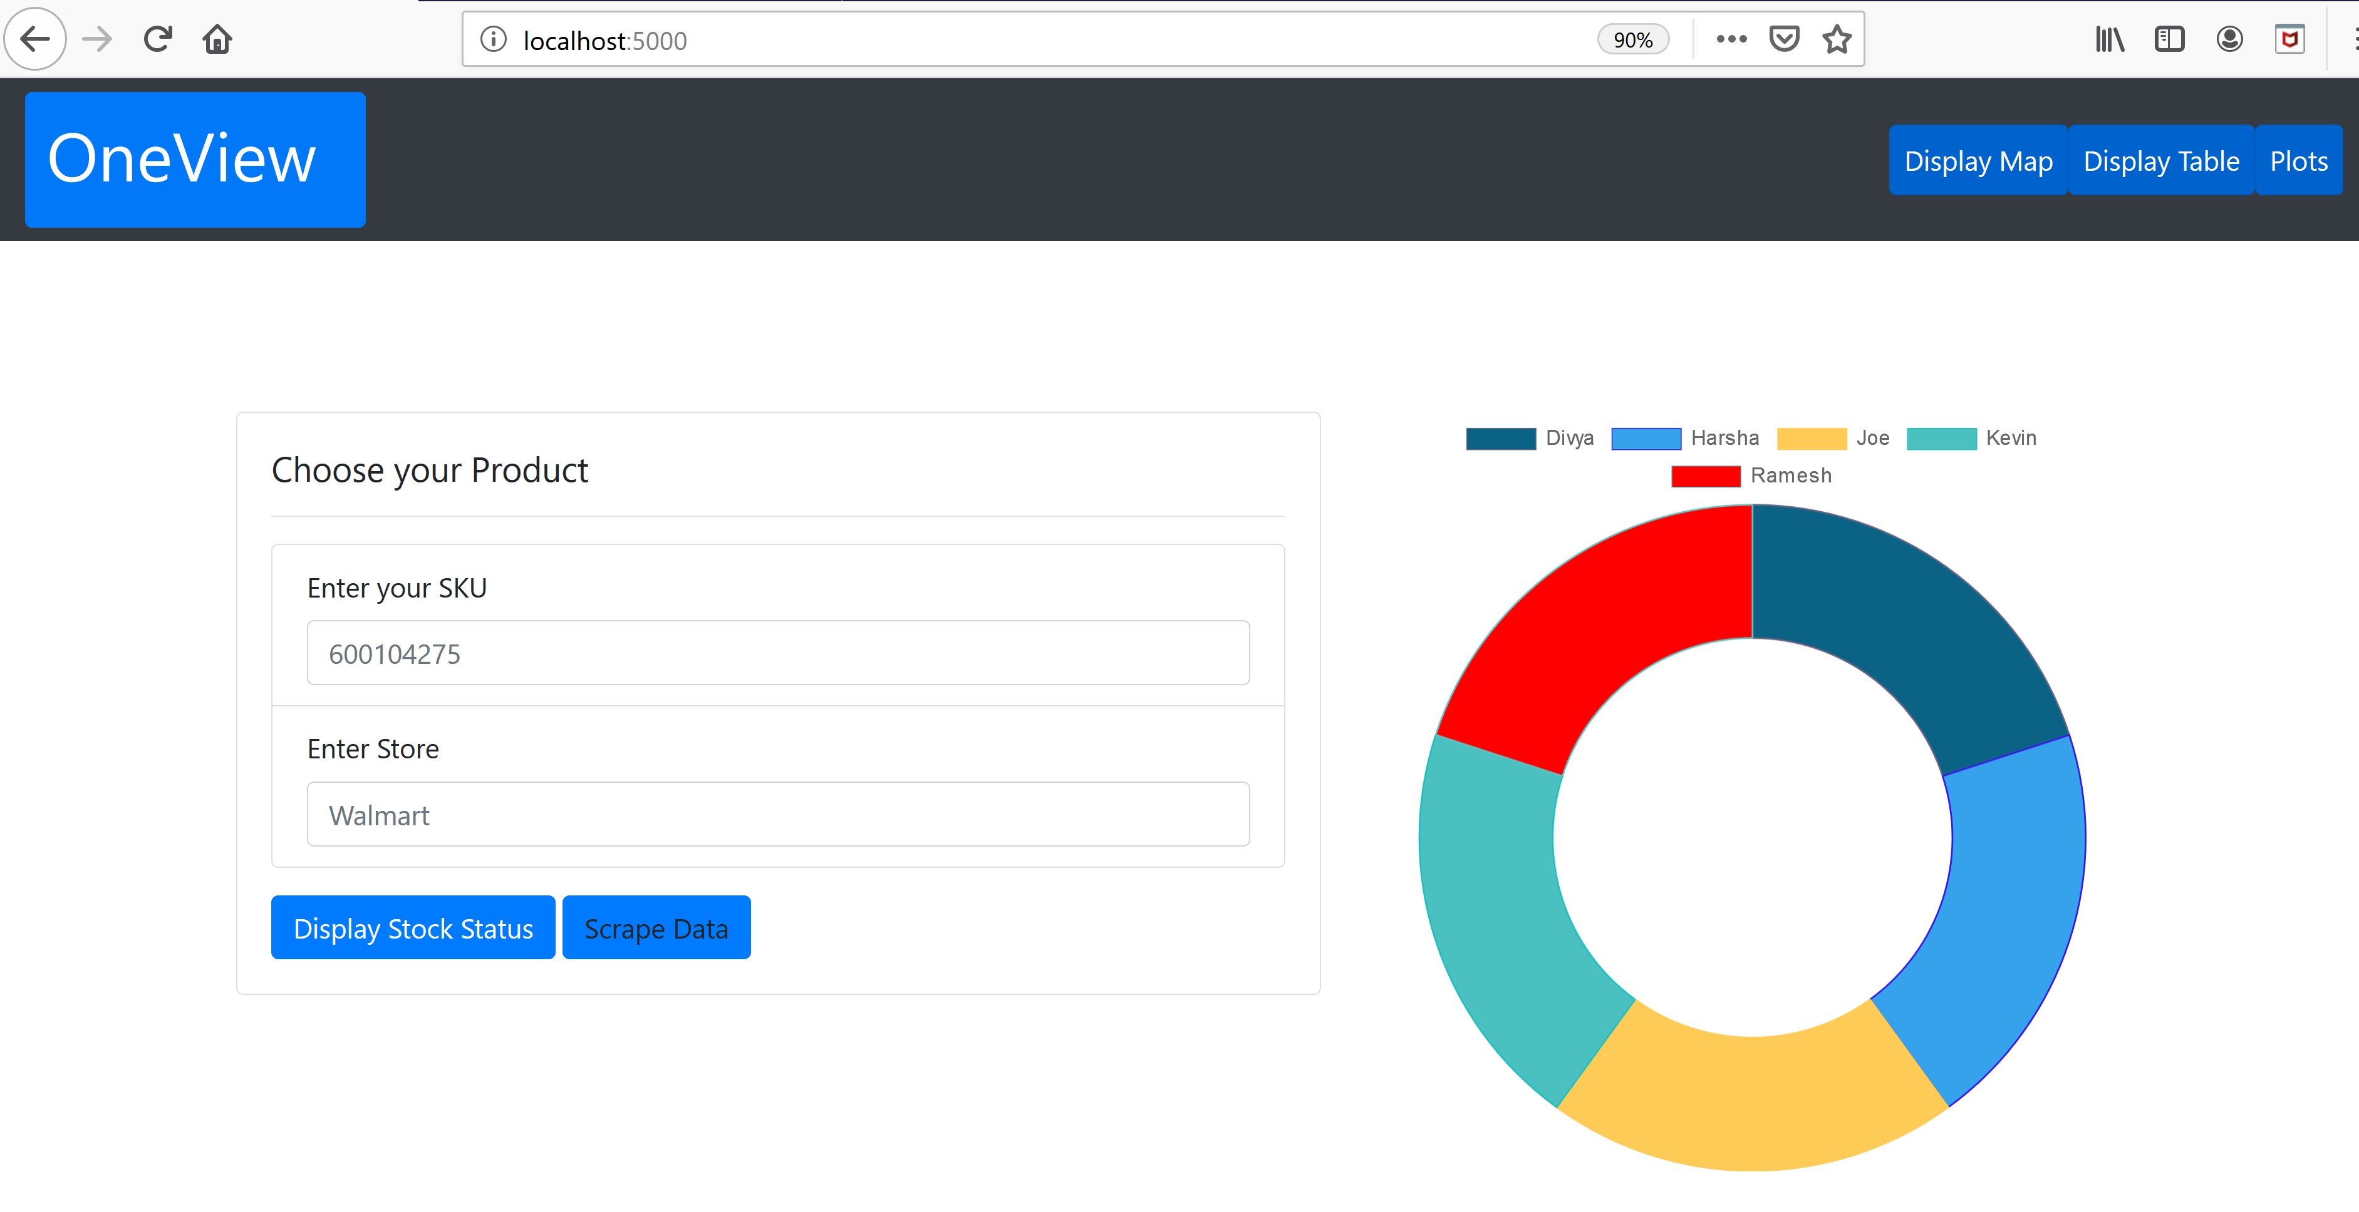
Interactive Landing page

Slide 10
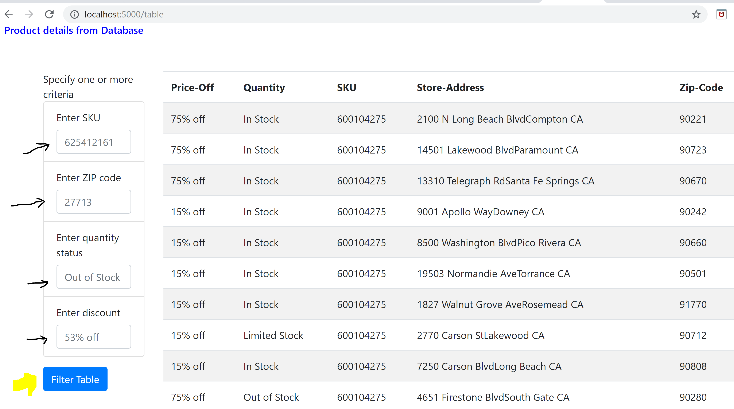
Table view for easy interactive filtering

Slide 11
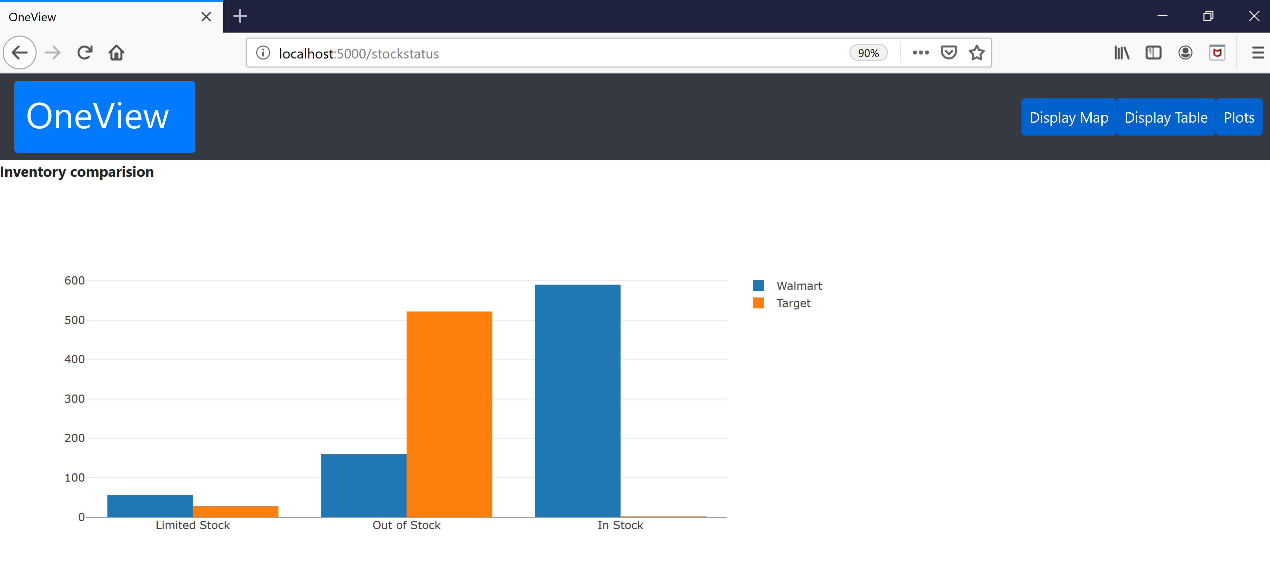
Inventory comparison

Slide 12
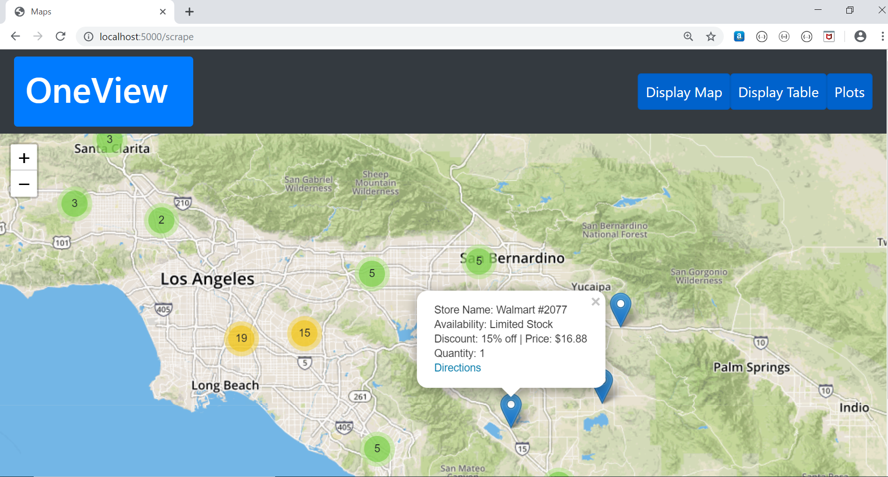
MAP VIEW

Slide 13
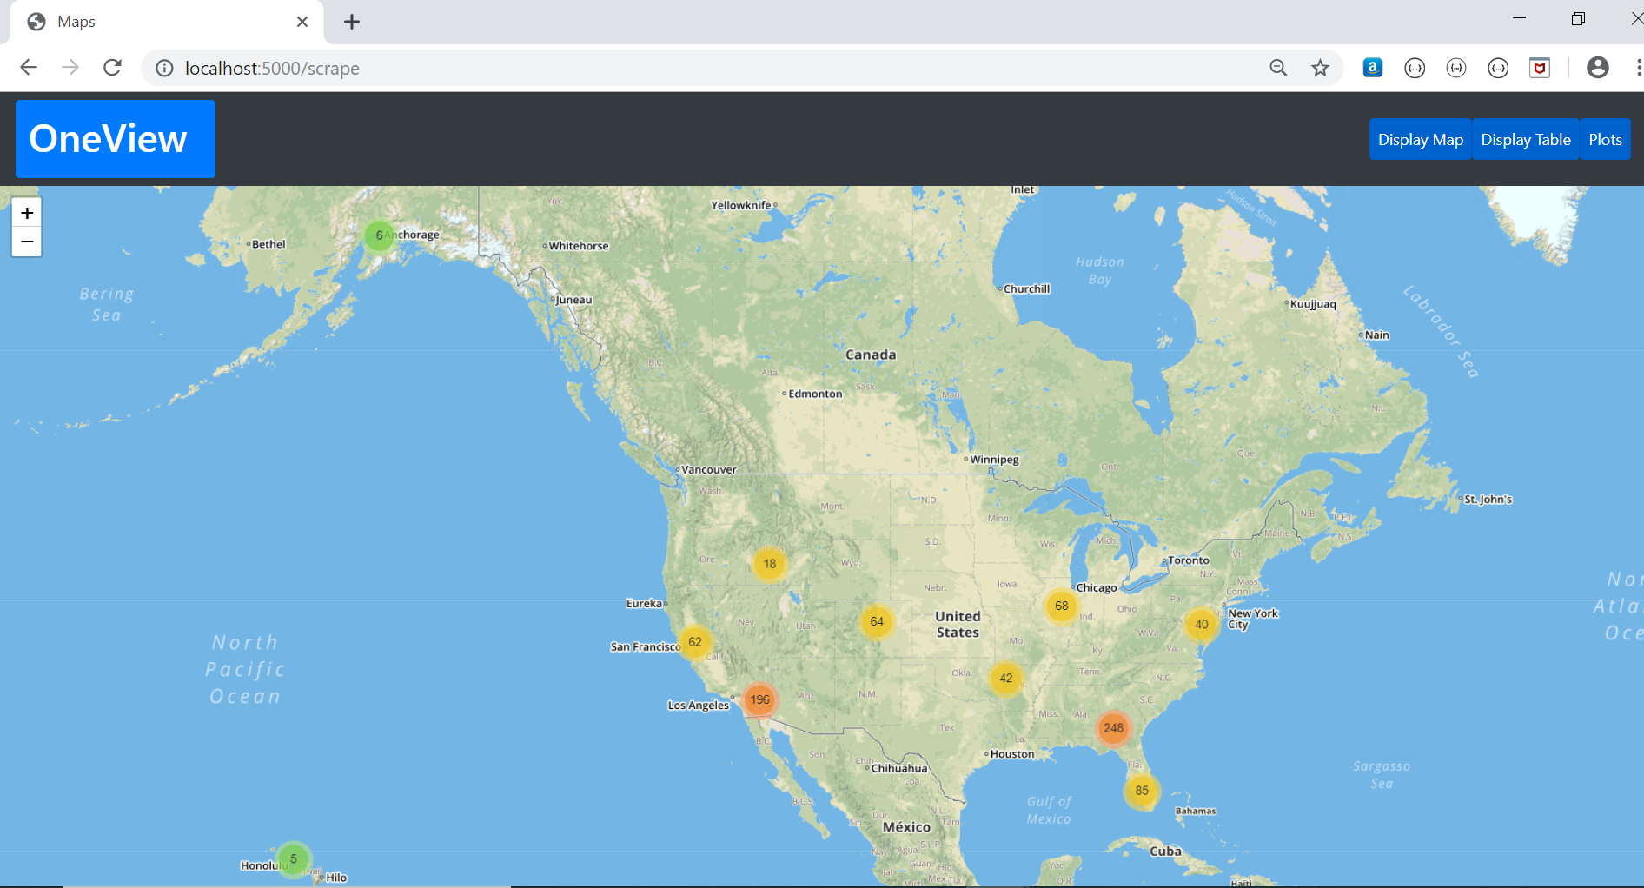
MAP VIEW

Slide 14
DEMO

Slide 15




Slide 16
Future enhancements post project
- Gather volumes of information for greater user capabilities
- Try other methods to prevent from blocking like proxy rotation
Splinter to simulate user
User-agent to simulate browser
Add time delays between each request to simulate user requests.
Proxy rotations.
- Expand scope to include other retailers
- Price and inventory comparisons + historical trends on products
- Predictive analytics: pricing trends + inventory levels (predict out-of-stock/re-stock)
- Built in logic to aid in user decision making + automated alerts for certain price/inventory

Slide 17

End result| User Success
Better Price
Quicker Decisions
Better Experience
No regrets

Slide 18

Thank You

